Slide 1
Курс «Речевые техологии»
Карпов Николай
SmartSpeech SberDevices
3 неделя

Slide 2
Логика курса
Общее понимание принципов работы диалоговых систем
Построение диалоговой системы при помощи SmartMarket
Методы анализа речевых сигналов
Распознавание речи
Синтез речи
Сегодня
Никакой математики!
Физика процесса формирования речи
Почему трудно понять певцов оперы?

Slide 3
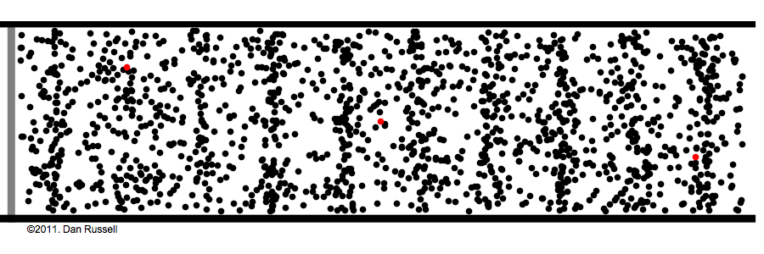
Звуковые волны - это продольные волны
Dan Rusell Figure

Slide 4
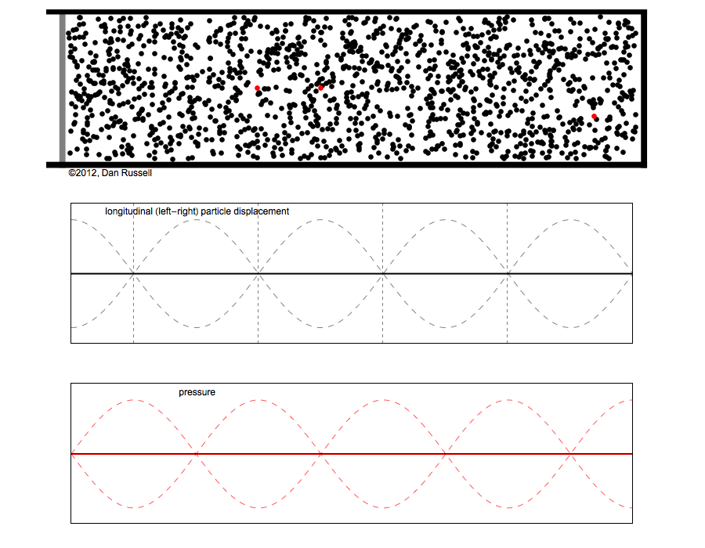
particle dispacment
pressure
Dan Rusell Figure

Slide 5
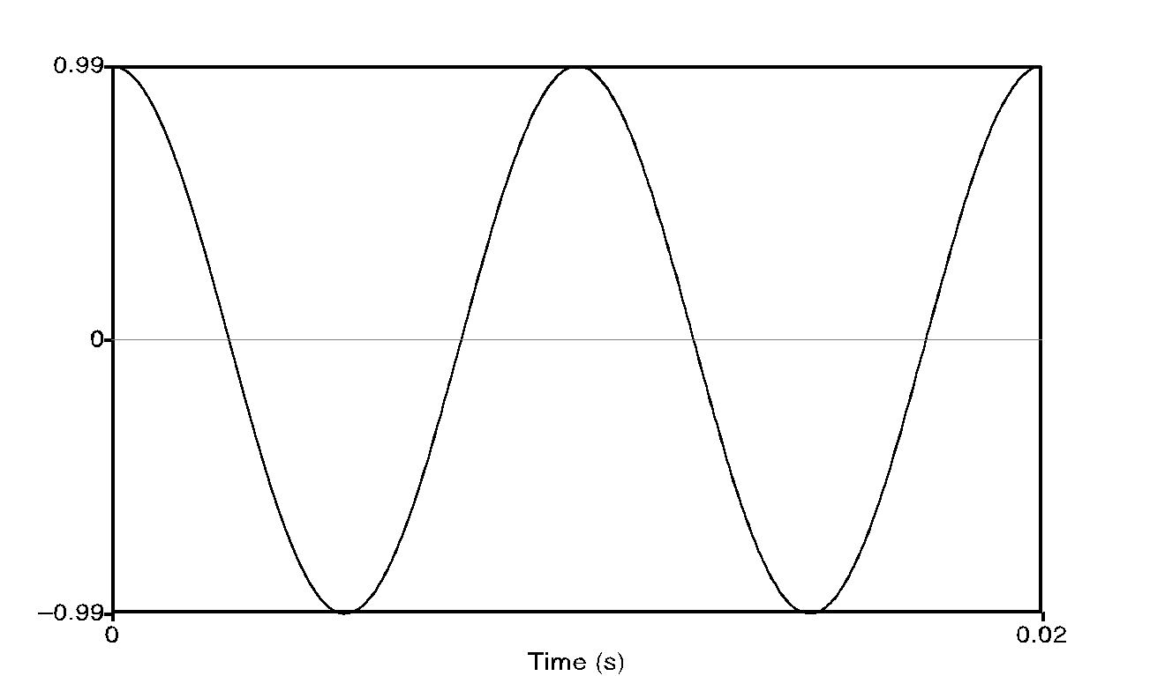
Remember High School Physics Simple Period Waves (sine waves)
Characterized by:
period: T
amplitude A
phase φ
Fundamental frequency
in cycles per second, or Hz
F₀=1/T
1 cycle

Slide 6
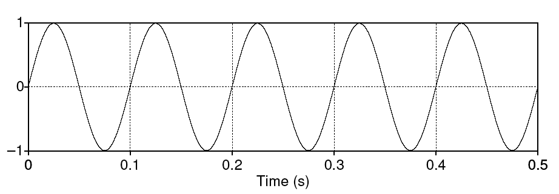
Simple periodic waves
Computing the frequency of a wave:
5 cycles in .5 seconds = 10 cycles/second = 10 Hz
Amplitude:
1
Equation:
Y = A sin(2πft)
The frequency of a wave:
5 cycles in .5 seconds = 10 cycles/second = 10 Hz
Amplitude: 1

Slide 7
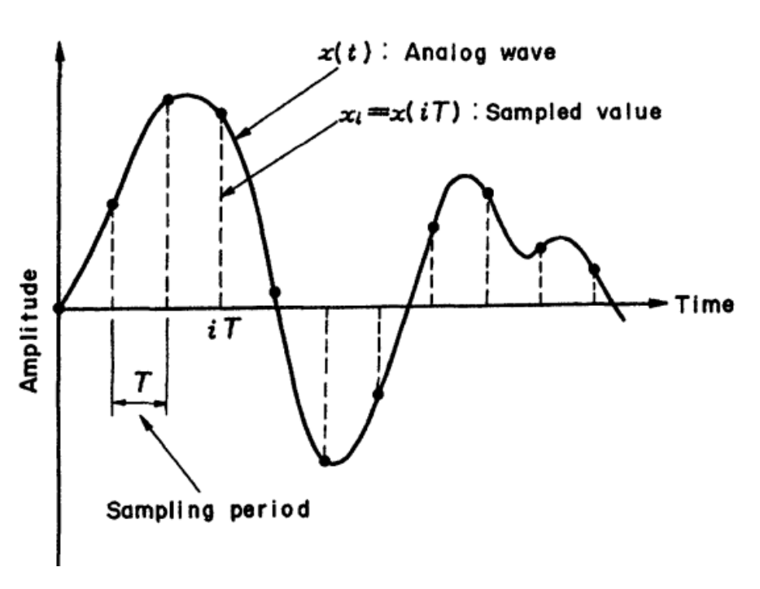
Период и частота дискретизации
F_{s} = 1/T_{s}

Slide 8
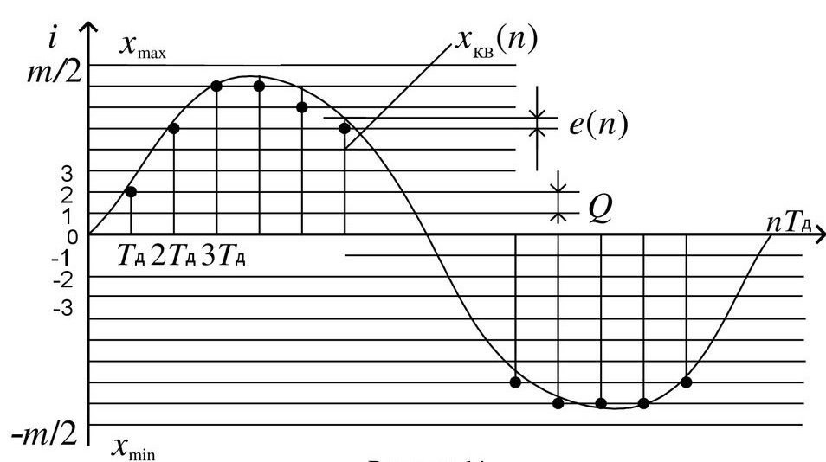
Уровни квантования

Slide 9
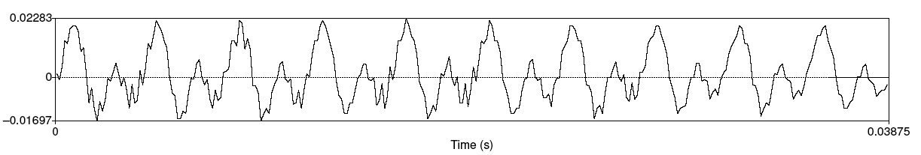
Звуковые волны речи
A little piece from the waveform of the vowel [iy]
X axis: time.
Y axis:
Amplitude = air pressure at that time
+: compression
0: normal air pressure,
-: rarefaction

Slide 10
Back to waves: Fundamental frequency
Waveform of the vowel [iy]
Frequency: 10 repetitions / .03875 seconds = 258 Hz
This is speed that vocal folds move, hence voicing
Each peak corresponds to an opening of the vocal folds
The low frequency of the complex wave is called the fundamental frequency of the wave or F0

Slide 11

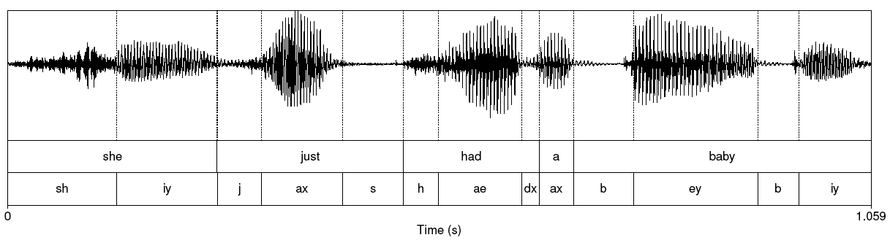
She just had a baby
Note that vowels all have regular amplitude peaks
Stop consonant
Closure followed by release
Notice the silence followed by slight bursts of emphasis: very clear for [b] of “baby”
Fricative: noisy. [sh] of “she” at beginning

Slide 12
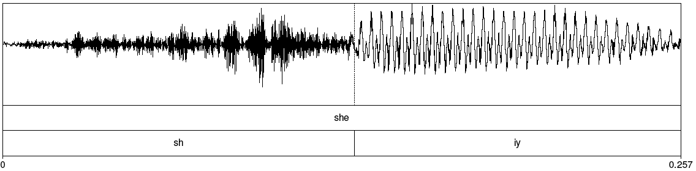
Fricative

Slide 13
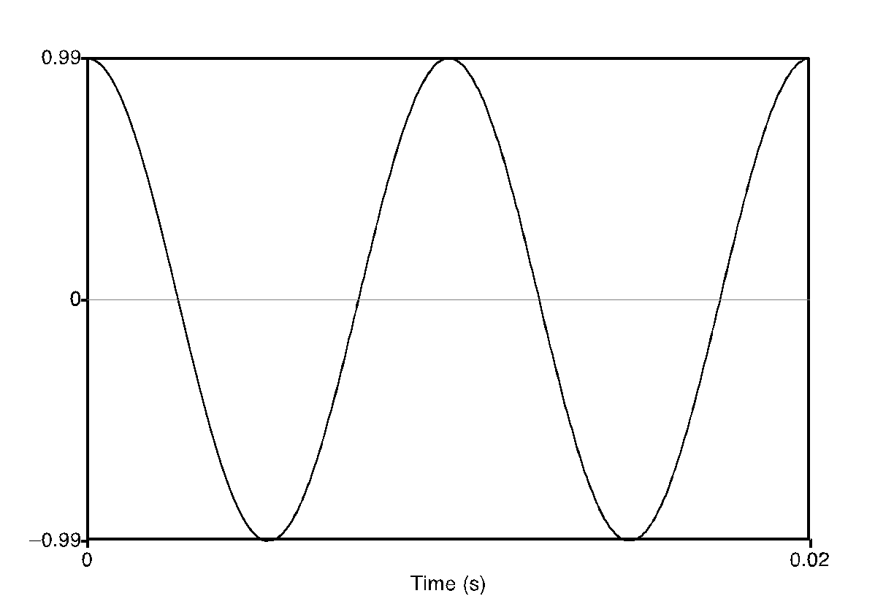
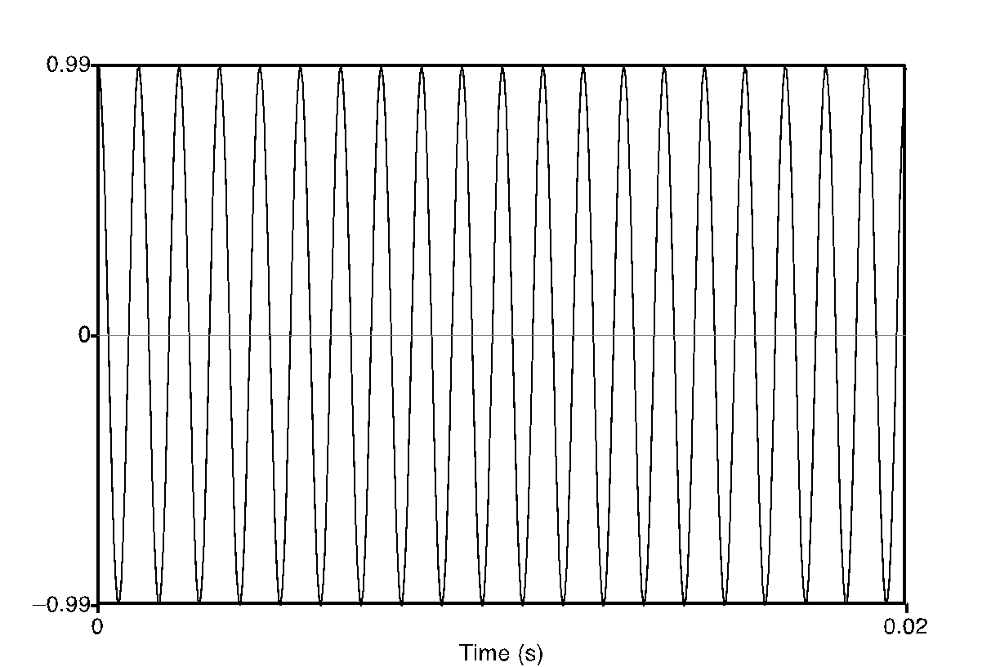
Back to freshman physics: Waves have different frequencies
100 Hz
1000 Hz

Slide 14
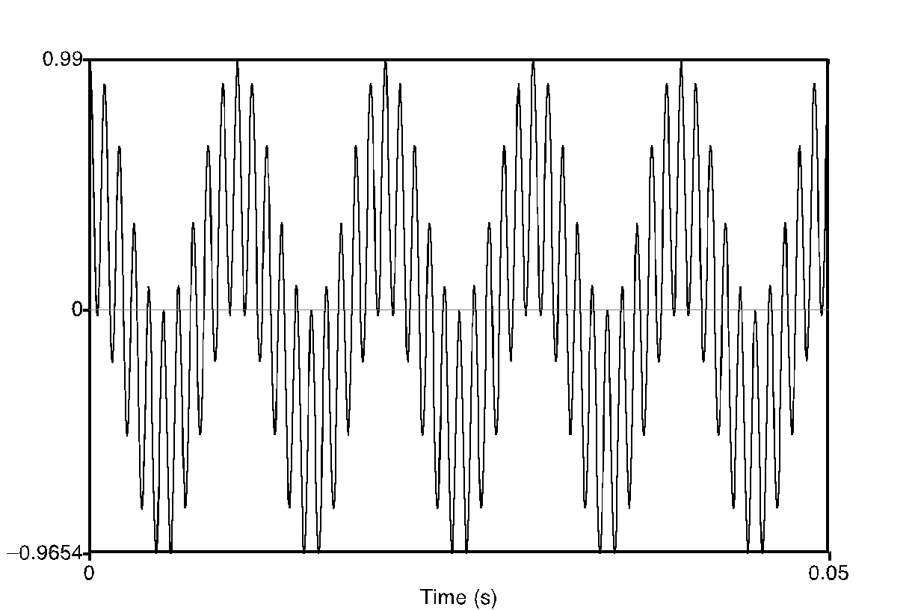
Complex waves: Adding a 100 Hz and 1000 Hz wave together

Slide 15
Spectrum
Amplitude
100
Frequency in Hz
1000
Frequency components (100 and 1000 Hz) on x-axis

Slide 16
Spectra continued
Fourier analysis: any wave can be represented as the (infinite) sum of sine waves of different frequencies (amplitude, phase)

Slide 17
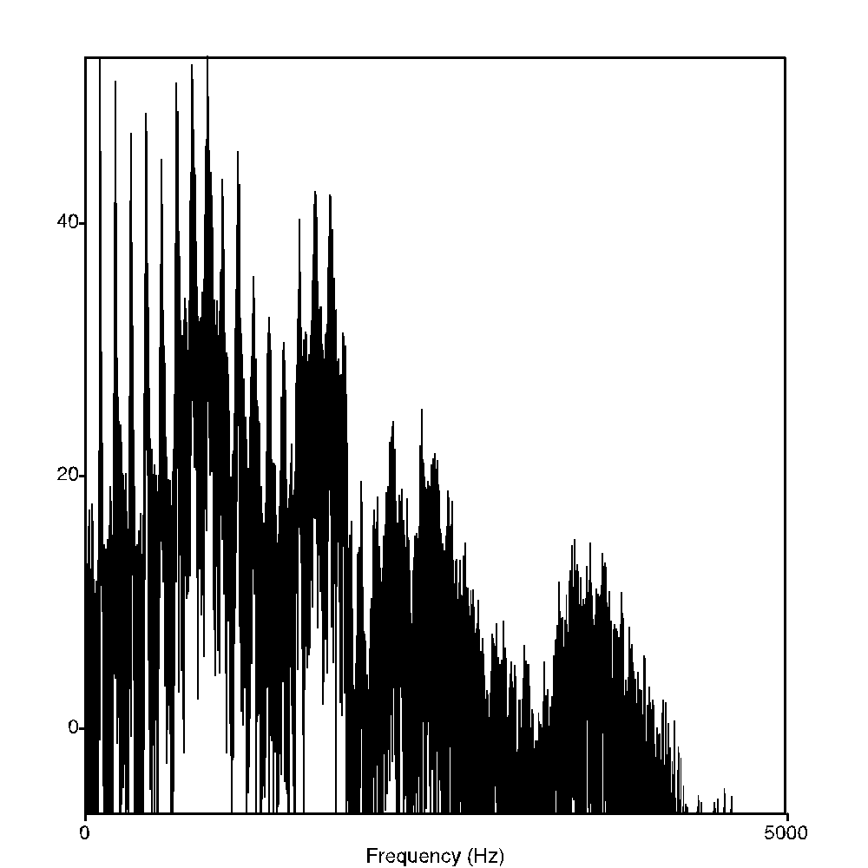
Spectrum of one instant in an actual soundwave: many components across frequency range

Slide 18
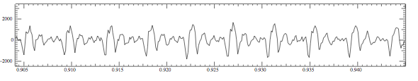
Part of [ae] waveform from “had”
Note complex wave repeating nine times in figure
Plus smaller waves which repeats 4 times for every large pattern
Large wave has frequency of 250 Hz (9 times in .036 seconds)
Small wave roughly 4 times this, or roughly 1000 Hz
Two little tiny waves on top of peak of 1000 Hz waves

Slide 19
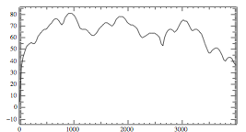
Back to spectrum
Spectrum represents these freq components
Computed by Fourier transform
x-axis shows frequency, y-axis shows magnitude (in decibels)
Peaks at 930 Hz, 1860 Hz, and 3020 Hz.

Slide 20
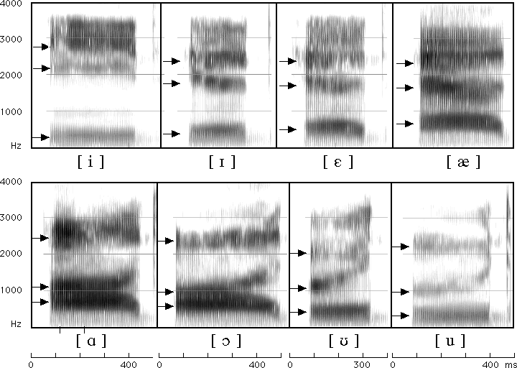
Seeing formants: the spectrogram

Slide 21
Formants
Vowels largely distinguished by 2 characteristic pitches.
One of them (the higher of the two) goes downward throughout the series iy ih eh ae aa ao ou u
The other goes up for the first four vowels and then down for the next four.
These are called "formants" of the vowels, lower is 1st formant, higher is 2nd formant.

Slide 22
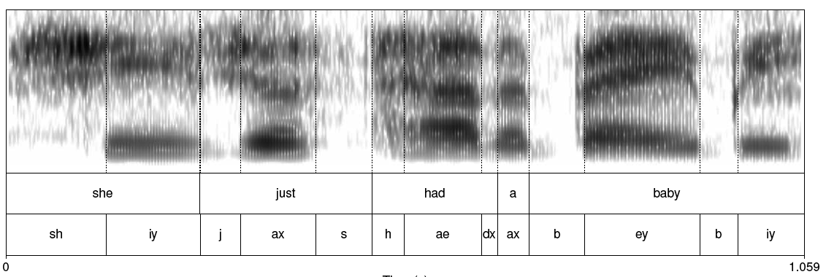
Spectrogram: spectrum + time dimension

Slide 23
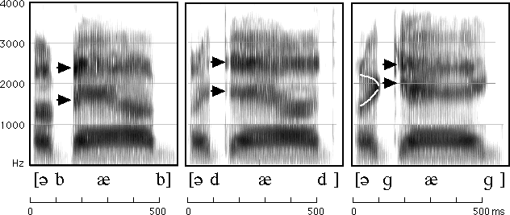
How to read spectrograms
bab: closure of lips lowers all formants: so rapid increase in all formants at beginning of "bab”
dad: first formant increases, but F2 and F3 slight fall
gag: F2 and F3 come together: this is a characteristic of velars. Formant transitions take longer in velars than in alveolars or labials
From Ladefoged “A Course in Phonetics”

Slide 24
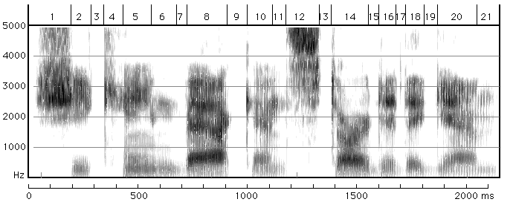
She came back and started again
1. lots of high-freq energy
3. closure for k
4. burst of aspiration for k
5. ey vowel;faint 1100 Hz formant is nasalization
6. bilabial nasal
7. short b closure, voicing barely visible.
8. ae; note upward transitions after bilabial stop at beginning
9. note F2 and F3 coming together for "k”
From Ladefoged “A Course in Phonetics”

Slide 25
Formants and the Source Filter Model

Slide 26
Different vowels have different formants
Every time the vocal cords open and close, pulse of air from the lungs is sharp tap on air in vocal tract.
Setting air in vocal cavity vibrating, producing different harmonics

Slide 27
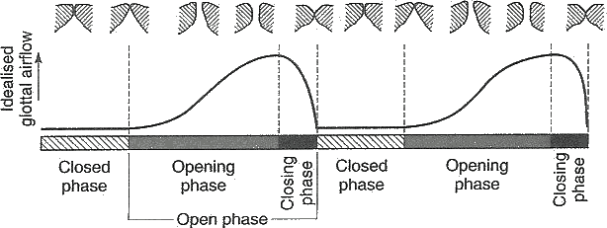
Vocal Fold Cycles

Slide 28
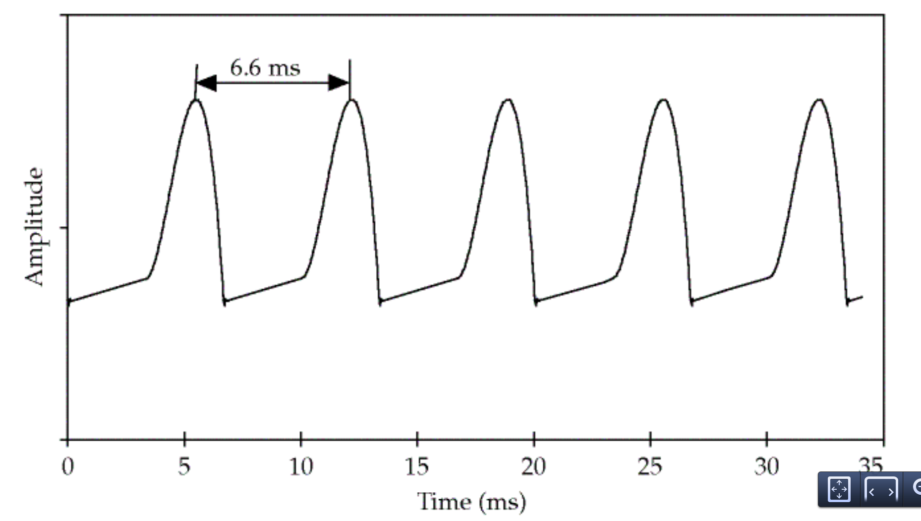
The vocal source at 150 Hz
a

Slide 29
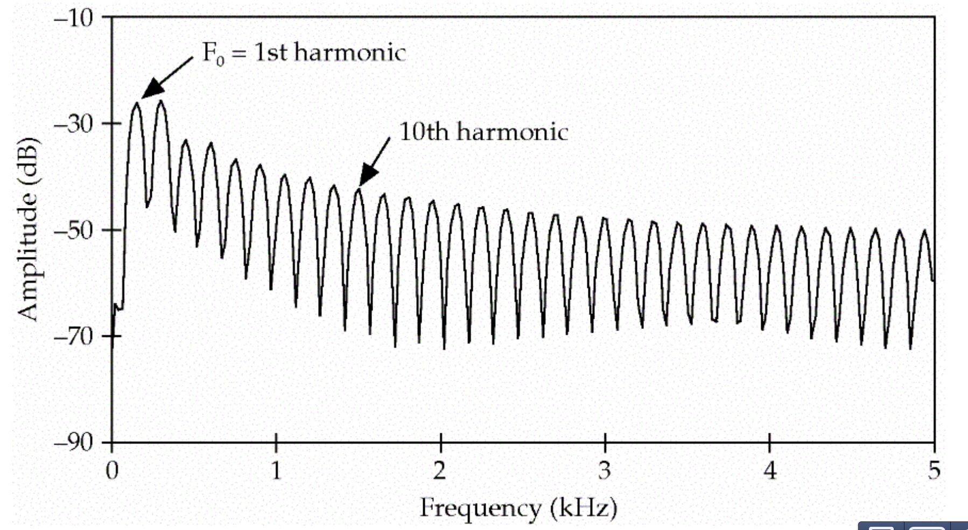
The harmonics
a

Slide 30
Source filter model of vowels
Any body of air will vibrate in a way that depends on its size and shape.
Vocal tract as "amplifier"; amplifies certain harmonics
Formants are result of different shapes of vocal tract.

Slide 31
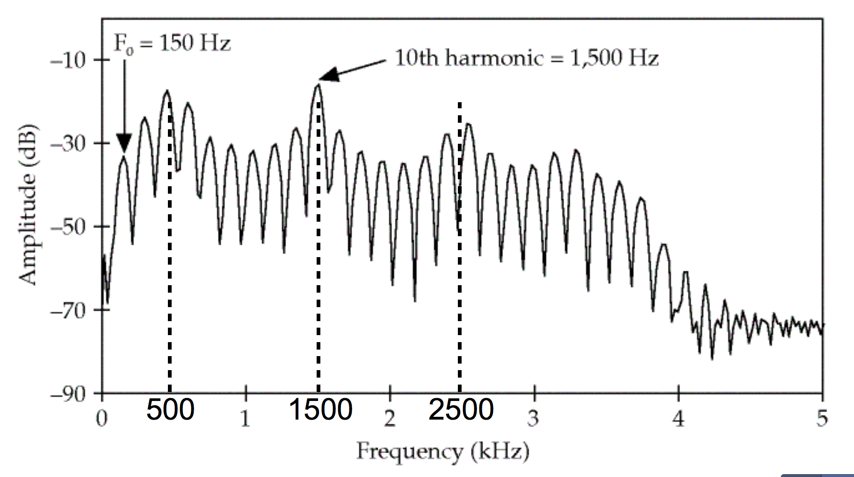
The oral cavity amplifies some harmonics
a

Slide 32
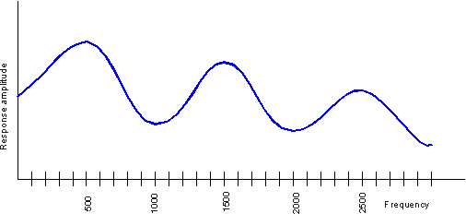
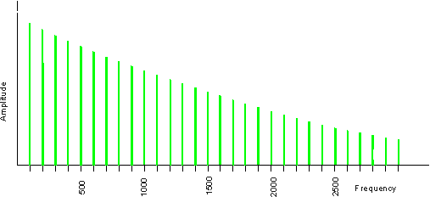
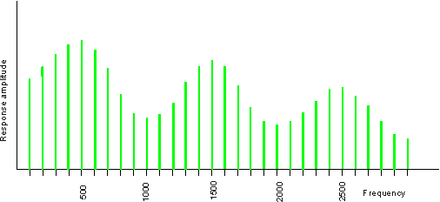
Source-filter model of speech production
Input
Filter
Output
Glottal spectrum
Vocal tract frequency
response function
Source and filter are independent, so:
Different vowels can have same pitch
The same vowel can have different pitch
Figures and text from Ratree Wayland slide from his website

Slide 33
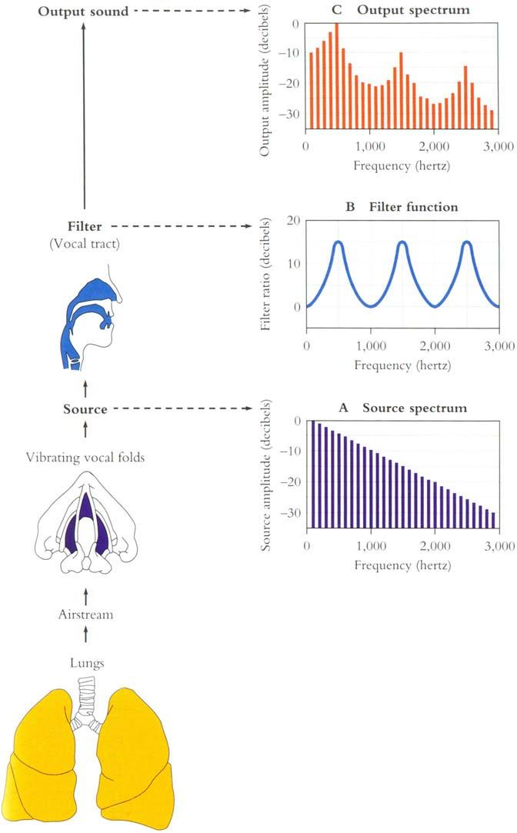

Slide 34
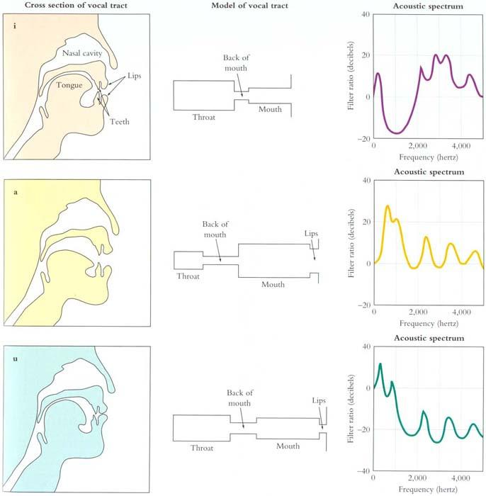
From
Mark
Liberman’s
Web site

Slide 35
Deriving schwa: how shape of mouth (filter function) creates formants of [ax]
f = c/λ
c = speed of sound (approx 35,000 cm/sec)
A sound with λ=10 meters has low frequency f = 35 Hz (35,000/1000)
A sound with λ=2 centimeters has high frequency f = 17,500 Hz (35,000/2)

Slide 36
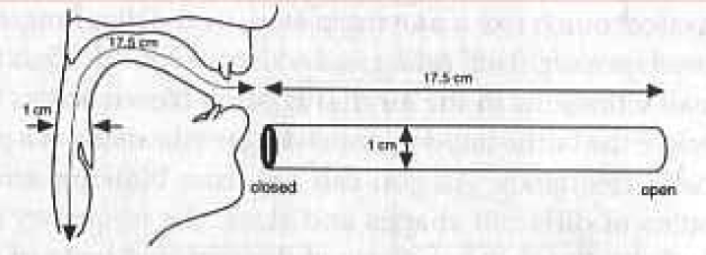
Resonances of the vocal tract
The human vocal tract as an open tube
Air in a tube of a given length will tend to vibrate at resonance frequency of tube.
Closed end
Open end
Length 17.5 cm.
Figure from Ladefoged(1996) p 117

Slide 37
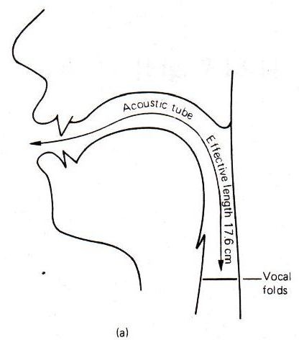
Resonances of the vocal tract
The human vocal tract as an open tube
Air in a tube of a given length will tend to vibrate at resonance frequency of tube.
Closed end
Open end
Length 17.5 cm.
Figure from W. Barry Speech Science slides

Slide 38
Resonances of the vocal tract
If vocal tract is cylindrical tube open at one end
Standing waves form in tubes
Waves will resonate if their wavelength corresponds to dimensions of tube
Constraint: Pressure differential should be maximal at (closed) glottal end and minimal at (open) lip end.
Next slide shows what kind of length of waves can fit into a tube with this contraint

Slide 39
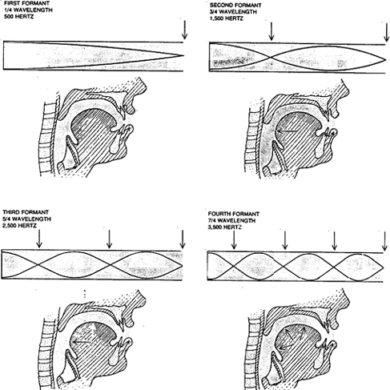
From Sundberg

Slide 40
Computing the 3 formants of schwa
Let the length of the tube be L
F1 = c/λ1 = c/(4L) = 35,000/4*17.5 = 500Hz
F2 = c/λ2 = c/(4/3L) = 3c/4L = 3*35,000/4*17.5 = 1500Hz
F3 = c/λ3 = c/(4/5L) = 5c/4L = 5*35,000/4*17.5 = 2500Hz
So we expect a neutral vowel to have 3 resonances at 500, 1500, and 2500 Hz
These vowel resonances are called formants

Slide 41
This can help solve a mystery of musical life:
Why are opera singers (especially sopranos) so hard to understand?

Slide 42
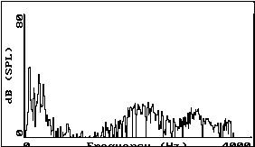
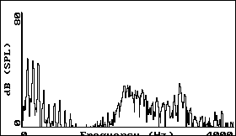
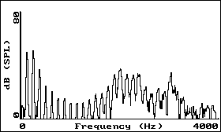
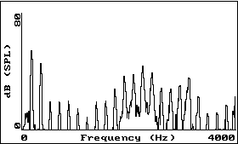
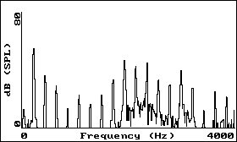
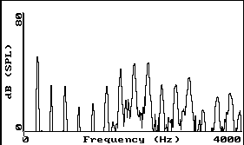
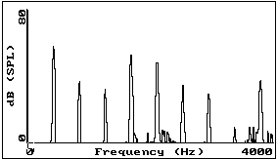
Vowel [i] sung at successively higher pitch.
1
2
3
4
5
6
7
Figures from Ratree Wayland slides from his website

Slide 43
Практикум
https://colab.research.google.com/drive/1fusWeBDOyp1FjzV9cy2VdpPhbNXYy96U?usp=sharing

Slide 44
Спасибо за внимание

